Slide 1
Harmonic Studies
A Year 2014 Approach
Presented to IEEE IAS – Atlanta Chapter
September 15, 2014
Presented by Bonita S. Martin, PE
TRC Engineers

Slide 2
Introduction to Presentation
Welcome
How this topic was chosen and by whom
Why I am the presenter
Intent of presentation
Not a tutorial
Ten thousand foot view
Discuss “new” technologies available
Discuss feedback from application engineers

Slide 3
Introduction to Power System Harmonics
Definition – what it is . . .
Harmonics are a mathematical way of describing distortion to a voltage or current waveform. The term harmonic refers to a component of a waveform that occurs at an integer multiple of the fundamental frequency.
Fourier theory tells us that any repetitive waveform can be defined in terms of summing sinusoidal waveforms which are integer multiples (or harmonics) of the fundamental frequency.

Slide 4
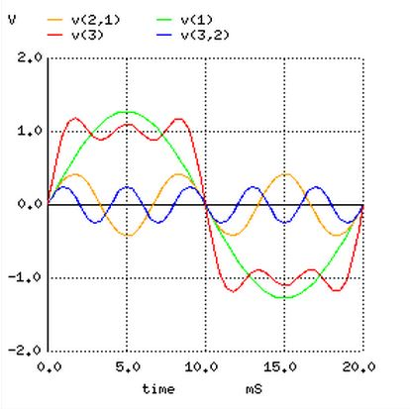
Introduction to Power System Harmonics

Slide 5
Introduction to Power System Harmonics
What it is not . . . .
Spikes
Dips
Impulses
Oscillations and other forms of transients
Grounding problems
Harmonic Sources
Switch-mode power supplies
DC converters
AC or DC motor drives
Static VAR compensators
Rectifier

Slide 6
Introduction to Power System Harmonics
Frequency of occurrence
Attention is out of proportion to existence of actual system performance problems.
Allen Bradley paper: “. . . rare occasions that harmonics are a problem . . . ”
Why so much attention? Problems were prevalent before manufacturer’s cleaned up their harmonic problems . . . circa 1990’s.

Slide 7
When System Problems Occur
Determine if harmonics are the cause
Is there a specific part of the system or specific equipment that is experiencing problems.
Investigate other possibilities.
System measurements – new choices.
Analyze captured data against acceptable levels in standards. TDD vs THD.

Slide 8
When System Problems Occur
If detrimental harmonics are present and compromising system functionality . . .
Model using actual system data – needs LOTS of monitoring.
Analyze for the purpose of designing a filter.
Avoid creating additional problems – for example, system resonance.
Refer to IEEE 399, Section 10.4.3 for an approximate calculation of harmonic resonant frequency.

Slide 9
When System Problems Occur
If detrimental harmonics are present and compromising system functionality (cont’d) . . .
IEEE 399, Section 10.5.9 details a reasonable, understandable approach to harmonic analysis.
See the following page for an excerpt.

Slide 10
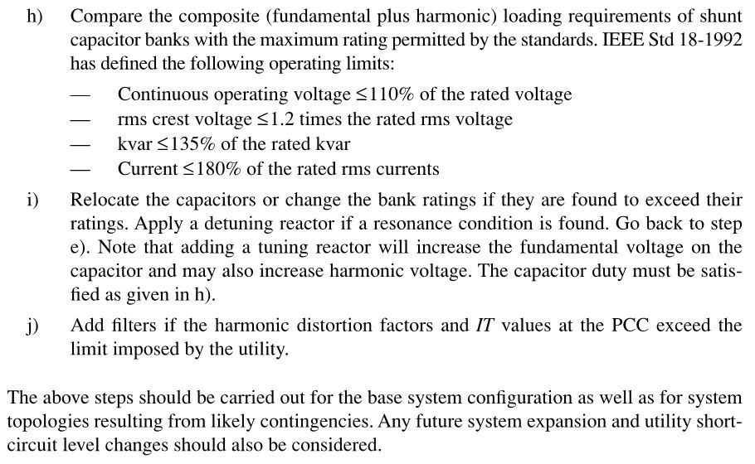
When System Problems Occur
If detrimental harmonics are present and compromising system functionality . . .

Slide 11
When System Problems Occur
Some harmful effects of high levels of harmonic distortion . . .
Increased heating of transformers, capacitors, motors, generators, neutral conductors.
Mis-operation of electronic equipment and protective relays that rely on voltage zero crossing detection.

Slide 12
When System Problems Occur
Red flags for when harmonic distortion level may become too high . . .
If an addition to an existing facility will result in the non-linear load comprising 25% or more of the load.
If an addition to an existing facility will result in over-loading the system’s capacity.
If you are indiscriminately adding power factor correction capacitors without considering the affect on the system and the presence of harmonic sources.

Slide 13
When System Problems Occur
Red flags for when harmonic distortion level may become too high (cont’d) . . .
A history of any of the following:
Failure of power-factor compensation capacitors.
Overheating of cables, transformers, or motors.
Mis-operation of protective relays or control devices.

Slide 14
Applicable Standards
IEEE StdTM 519 - 2014
Is a “Recommended Practice”, not a “Standard”.
Addresses the steady state condition.
Is a “system” practice, not an “equipment” practice.
Only addresses harmonic limits at PCC, not within the facility.

Slide 15
Applicable Standards
IEEE StdTM 519 - 2014
Maximum harmonic current distortion limits:
PCC: point on a public power supply system, electrically nearest to a particular load, at which other loads are, or could be, connected.
I_{L} = maximum demand load current at PCC under normal load operating conditions.

Slide 16
Applicable Standards
IEEE StdTM 519 - 2014
Maximum harmonic current distortion limits:
Maximum Demand Load Current, I_{L}: established at PCC and should be taken as the sum of the current corresponding to the maximum demand during each of the twelve previous months divided by 12.
I_{SC} = maximum short-circuit current at PCC.

Slide 17
Applicable Standards
IEEE Std 519TM – 2014
Current distortion limits – reference Sections 5.2, 5.3, 5.4.

Slide 18
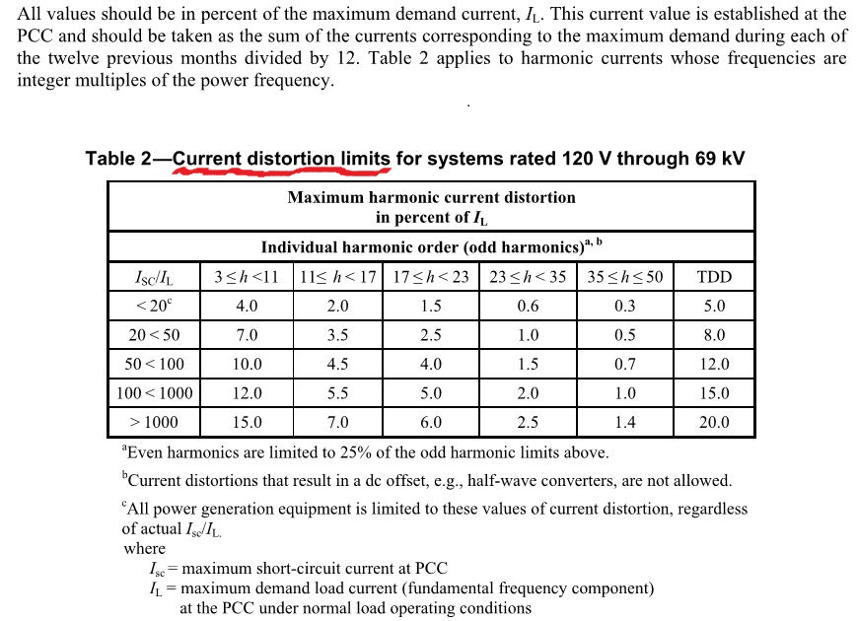
Applicable Standards
IEEE Std 519TM - 2014

Slide 19
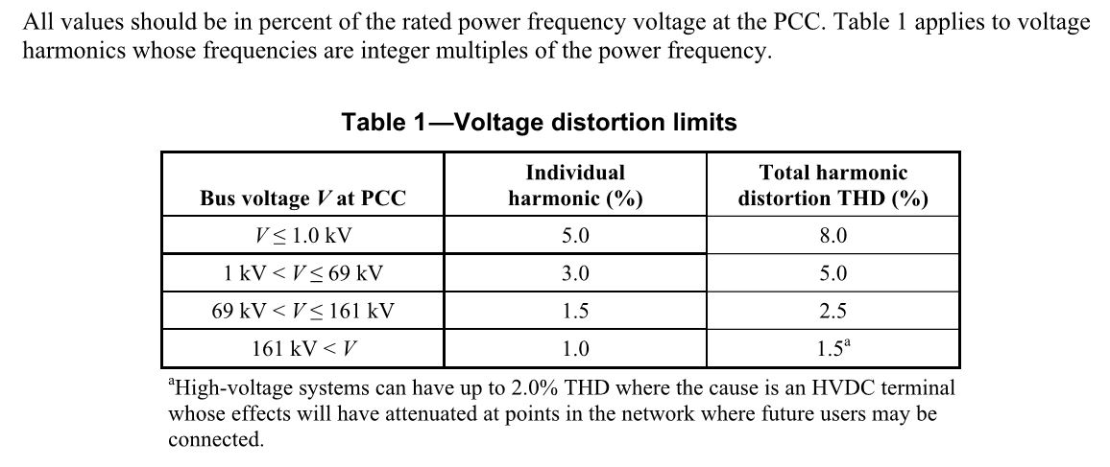
Applicable Standards
IEEE Std 519TM - 2014
Voltage distortion limits revised – new voltage range breakdown – reference Section 5.1.

Slide 20
Applicable Standards
IEEE Std 519TM - 2014
THD (total harmonic distortion): ratio of the root mean square of the harmonic content, considering harmonic components up to the 50th order and specifically excluding interharmonics, expressed as a percent of the fundamental.
This is what is measured by power quality analyzer.

Slide 21
Applicable Standards
IEEE Std 519TM - 2014
TDD (total demand distortion): ratio of the root mean square of the harmonic content, considering harmonic components up to the 50th order and specifically EXCLUDING interharmonics, expressed as a percent of maximum demand current.
This value appears in the IEEE 519 current distortion limit charts.

Slide 22
Applicable Standards
IEEE Std 519TM - 2014
Therefore, a certain amount of post-processing of harmonic measurement data is necessary to properly assess IEEE 519 current distortion limits.
The difference between THD and TDD is important because it prevents a user from being penalized for harmonics during periods of light loading.

Slide 23
Applicable Standards
IEEE StdTM 519 - 2014
Interharmonic (component): a frequency component of a periodic quantity that is not an integer multiple of the frequency at which the supply system is operating.
Chapter 4 contains new info regarding harmonic measurements – instruments must comply with IEC 61000-4-7 and IEC 61000-4-30.
Reduced from 14 chapters in the 1992 Standard to five chapters – tutorial info removed.

Slide 24
Applicable Standards
IEEE Std 519TM - 2014
A few notes
Most short circuit studies address only significant motor load. This means additional system modeling is required for harmonic analysis.
Suggest gathering demand load data for each low voltage substation or switchboard. This assists with creating an accurate model.

Slide 25
Applicable Standards
IEEE Std 519TM - 2014
Normative References:
IEC Standard 61000-4-7 - General Guide on Harmonics and Interharmonics Measurement and Instrumentation, for Power Supply Systems and Equipment Connected Thereto
IEC Standard 61000-4-30 - Power Quality Measurement Methods

Slide 26
Applicable Standards
IEEE Std 519TM - 2014
Normative References (cont’d):
IEC Standard 61000-4-15 - Testing and Measurement Techniques – Flickermeter -Functional and Design Specifications
IEEE Std 1453™ - IEEE Recommended Practice—Adoption of IEC 61000-4-15:2010, Electromagnetic Compatibility (EMC) - Testing and Measurement Techniques – Flickermeter -Functional and Design Specifications

Slide 27
Applicable Standards
IEEE StdTM 399 – 1997, Chapter 10
IEEE Recommended Practice for Industrial and Commercial Power System Analysis
IEEE StdTM 1531 – 2003
IEEE Guide for Application and Specification of Harmonic Filters
IEEE StdTM 1159 – 2009
IEEE Recommended Practice for Monitoring Electric Power Quality
IEEE StdTM 18 – 1992
IEEE Standard for Shunt Power Capacitors

Slide 28
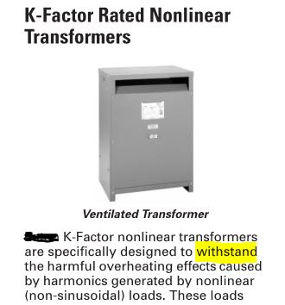
Final Thoughts and Observations
K-factor transformers WITHSTAND harmonics. Not the same thing as Harmonic Mitigating transformers.

Slide 29
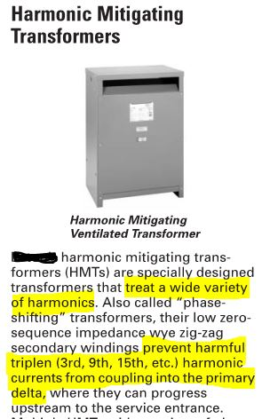
Final Thoughts and Observations

Slide 30
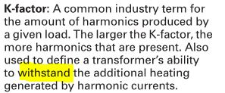
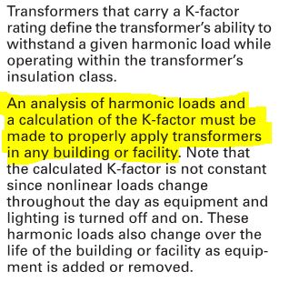
Final Thoughts and Observations
K-factor definition:
To properly apply K-factor transformers:

Slide 31
Final Thoughts and Observations
K-factor calculation – readily available info on equipment manufacturer’s website:
Point of reference:
Data center raised floor 100% non-linear load.
Prominent data center design firm specs K-4 transformers with 25% over-sized neutral.

Slide 32
Final Thoughts and Observations
“MCCs to be IEEE 519 compliant . . .”
The term “IEEE 519 compliant” when applied to electrical power distribution equipment is valid only when that equipment is service entrance equipment.

Slide 33
Final Thoughts and Observations
More up-front design desired.
Contradictory, ambiguous, or confusing specs – “six pulse drives shall meet IEEE 519”.
IEEE 519 does not apply to generator sources.
Monitoring, modern style – no triggers and almost unlimited data storage (one to two years of data).
18 pulse drives may not be the best solution.

Slide 34
Final Thoughts and Observations
Harmonics analysis should address all system operating conditions and switching configurations.
Ensure analysis addresses generator sources only (one, two, three generators) –
system impedance is different for these conditions.
I_{SC}/I_{L} ratio is different (used to determine harmonic current limits – reference IEEE Std 519TM - 2014, Table 2)

Slide 35
Final Thoughts and Observations
Harmonic studies are expensive, time-consuming, based on lots of assumptions, and require lots of measurements.
Don’t use a harmonic study to determine the level of distortion in your system – that is accomplished by monitoring. The data from monitoring is also used to create an accurate system model.
Insist that analysis results be compiled into a summary table.

Slide 36
Bonus – Two Items of Information Regarding Arc-Flash Hazard Studies
NEC 2014, Article 240.87 – Arc Energy Reduction
Where the highest continuous current trip setting for which the actual overcurrent device installed in a circuit breaker is rated or can be adjusted is 1200 A or higher, 240.87 (A) and (B) shall apply.
(A) Documentation. Documentation shall be available to those authorized to design, install, operate, or inspect the installation as to the location of the circuit breaker(s).

Slide 37
Bonus – Two Items of Information Regarding Arc-Flash Hazard Studies
NEC 2014, Article 240.87 – Arc Energy Reduction
(B) Method to Reduce Clearing Time. One of the following or approved equivalent means shall be provided:
Zone-selective interlocking
Differential relaying
Energy-reducing maintenance switching with local status indicator
Energy-reducing active arc flash mitigation system
An approved equivalent means

Slide 38
Bonus – Two Items of Information Regarding Arc-Flash Hazard Studies
OSHA General Industry Standard vs Construction Standard
OSHA General Industry Standard applies to tasks that are maintenance or repair tasks.
Voltage testing
Trouble Shooting
Diagnostics, including IR Thermography
Startup of Equipment
Ref: OSHA 29 CFR 1910, Subpart S-Sections 1910.331 - .335, Section 1910.399 of Subpart S

Slide 39
Bonus – Two Items of Information Regarding Arc-Flash Hazard Studies
OSHA General Industry Standard vs Construction Standard (cont’d)
OSHA Construction Standard applies to tasks that add value to a facility. These tasks are NOT addressed in NFPA 70E and NO live work is allowed.
Installing a new circuit breaker
Modifying a circuit within an existing panel
Installing a new bus duct switch
Installing a new motor control bucket
Ref: OSHA 29 CFR 1926, Subpart K – Sections 1926.416 - .417 and Section 1926.449 (2) of Subpart K

Slide 40
TRC Engineers
Bonita S. Martin, PE
P: 770-545-2098
E: BSMartin@trcsolutions.com

